Slide 1
WEB AND MOBILE
APP DESIGN
Session 12
Course : Software Engineering
Effective Period : Desember 2017

Slide 2
These slides have been adapted from
Pressman, R.S. (2015). Software Engineering : A Practioner's Approach. 8th ed. McGraw-Hill Companies.Inc, Americas, New York. ISBN : 978 1 259 253157. Chapter 17 and 18
Acknowledgement

Slide 3
LO2 : Explain the software engineering practices and business environment
Learning Objectives

Slide 4
Contents
WebApps Design Quality
WebApp Design Goals
Design Pyramid for WebApps
WebApp Interface Design
Aesthetic Design
Content Design
Architecture Design
Navigation Design
Component-Level Design
Mobile App Design

Slide 5
WebApps Design Quality
Design & WebApp Quality
Security
  Rebuff external attacks
  Exclude unauthorized access
  Ensure the privacy of users/customers
Availability
  the measure of the percentage of time that a WebApp is available for use
Scalability
  Can the WebApp and the systems with which it is interfaced handle significant variation in user or transaction volume
Time to Market

Slide 6
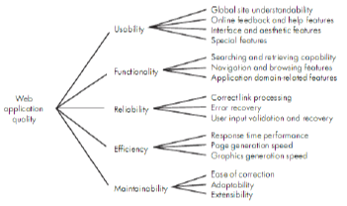
WebApps Design Quality
Quality Requirement Tree

Slide 7
WebApp Design Goals
Simplicity
  Better to strive for moderation and simplicity
Consistency
  Content should be constructed consistently
  Graphic design (aesthetics) should present a consistent look across all parts of the WebApp
  Architectural design should establish templates that lead to a consistent hypermedia structure
  Interface design should define consistent modes of interaction, navigation and content display
  Navigation mechanisms should be used consistently across all WebApp elements

Slide 8
WebApp Design Goals
Identity
  Establish an “identity” that is appropriate for the business purpose
Robustness
  The user expects robust content and functions that are relevant to the user’s needs
Navigability
  Designed in a manner that is intuitive and predictable
Visual appeal
  The look and feel of content, interface layout, color coordination, the balance of text, graphics and other media, navigation mechanisms must appeal to end-users
Compatibility
  With all appropriate environments and configurations

Slide 9
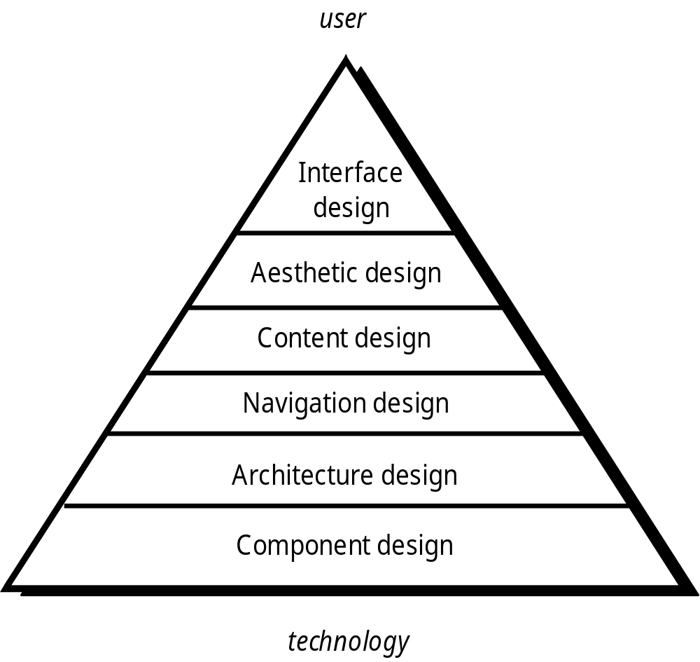
Design Pyramid for WebApps

Slide 10
WebApp Interface Design
Effective WebApp Interfaces
Bruce Tognozzi [TOG01] suggests…
  Effective interfaces are visually apparent and forgiving, instilling in their users a sense of control. Users quickly see the breadth of their options, grasp how to achieve their goals, and do their work.
  Effective interfaces do not concern the user with the inner workings of the system. Work is carefully and continuously saved, with full option for the user to undo any activity at any time.
  Effective applications and services perform a maximum of work, while requiring a minimum of information from users.

Slide 11
WebApp Interface Design
Interface Design Principles-I
Anticipation—A WebApp should be designed so that it anticipates the use’s next move.
Communication—The interface should communicate the status of any activity initiated by the user
Consistency—The use of navigation controls, menus, icons, and aesthetics (e.g., color, shape, layout)
Controlled autonomy—The interface should facilitate user movement throughout the WebApp, but it should do so in a manner that enforces navigation conventions that have been established for the application.
Efficiency—The design of the WebApp and its interface should optimize the user’s work efficiency, not the efficiency of the Web engineer who designs and builds it or the client-server environment that executes it.

Slide 12
WebApp Interface Design
Interface Design Principles-II
Focus—The WebApp interface (and the content it presents) should stay focused on the user task(s) at hand.
Fitt’s Law—“The time to acquire a target is a function of the distance to and size of the target.”
Human interface objects—A vast library of reusable human interface objects has been developed for WebApps.
Latency reduction—The WebApp should use multi-tasking in a way that lets the user proceed with work as if the operation has been completed.
Learnability— A WebApp interface should be designed to minimize learning time, and once learned, to minimize relearning required when the WebApp is revisited.

Slide 13
WebApp Interface Design
Interface Design Principles-III
Maintain work product integrity—A work product (e.g., a form completed by the user, a user specified list) must be automatically saved so that it will not be lost if an error occurs.
Readability—All information presented through the interface should be readable by young and old.
Track state—When appropriate, the state of the user interaction should be tracked and stored so that a user can logoff and return later to pick up where she left off.
Visible navigation—A well-designed WebApp interface provides “the illusion that users are in the same place, with the work brought to them.”

Slide 14
Aesthetic Design
Don’t be afraid of white space.
Emphasize content.
Organize layout elements from top-left to bottom right.
Group navigation, content, and function geographically within the page.
Don’t extend your real estate with the scrolling bar.
Consider resolution and browser window size when designing layout.

Slide 15
Content Design
Develops a design representation for content objects
  For WebApps, a content object is more closely aligned with a data object for conventional software
Represents the mechanisms required to instantiate their relationships to one another.
  analogous to the relationship between analysis classes and design components.
A content object has attributes that include content-specific information and implementation-specific attributes that are specified as part of design

Slide 16
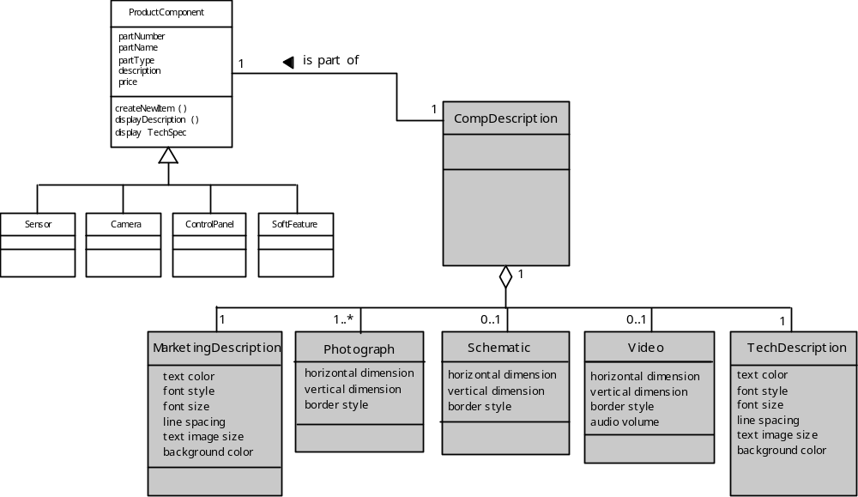
Content Design
Design of Content Objects

Slide 17
Architecture Design
Content architecture focuses on the manner in which content objects (or composite objects such as Web pages) are structured for presentation and navigation.
  The term information architecture is also used to connote structures that lead to better organization, labeling, navigation, and searching of content objects.
WebApp architecture addresses the manner in which the application is structured to manage user interaction, handle internal processing tasks, effect navigation, and present content.
Architecture design is conducted in parallel with interface design, aesthetic design and content design.

Slide 18
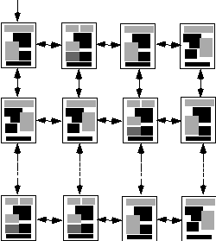
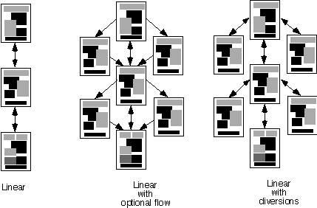
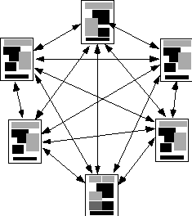
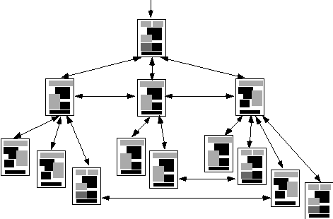
Architecture Design
Content Architecture
Grid
structure
Linear
Linear with
diversions
Linear with
Optional flow
Grid Structure
Hierarchical
structure
Hierarchical structure
Network structure

Slide 19
Architecture Design
MVC Architecture
The model contains all application specific content and processing logic, including
  all content objects
  access to external data/information sources,
  all processing functionality that are application specific
The view contains all interface specific functions and enables
  the presentation of content and processing logic
  access to external data/information sources,
  all processing functionality required by the end-user.
The controller manages access to the model and the view and coordinates the flow of data between them.

Slide 20
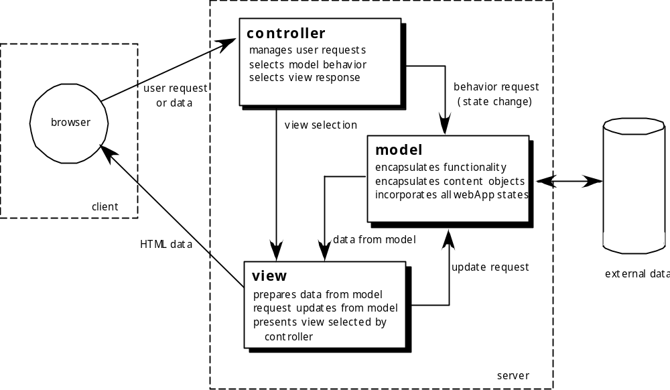
Architecture Design
MVC Architecture

Slide 21
Navigation Design
Begins with a consideration of the user hierarchy and related use-cases
  Each actor may use the WebApp somewhat differently and therefore have different navigation requirements
As each user interacts with the WebApp, she encounters a series of navigation semantic units (NSUs)
  NSU—“a set of information and related navigation structures that collaborate in the fulfillment of a subset of related user requirements”

Slide 22
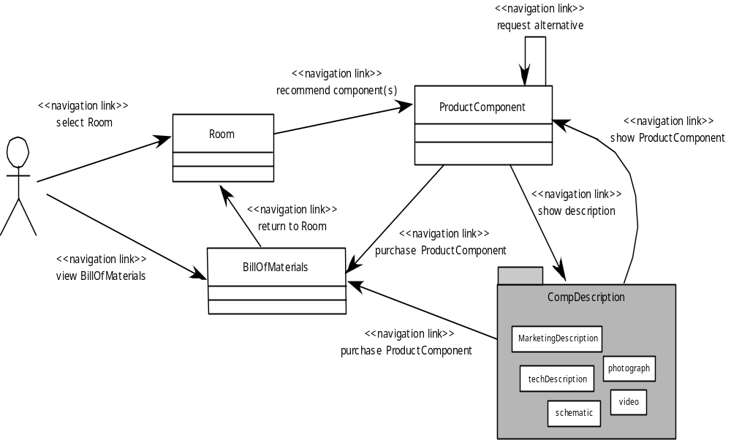
Navigation Design
Creating an NSU

Slide 23
Navigation Design
Navigation Syntax
Individual navigation link—text-based links, icons, buttons and switches, and graphical metaphors..
Horizontal navigation bar—lists major content or functional categories in a bar containing appropriate links. In general, between 4 and 7 categories are listed.
Vertical navigation column
  lists major content or functional categories
  lists virtually all major content objects within the WebApp.
Tabs—a metaphor that is nothing more than a variation of the navigation bar or column, representing content or functional categories as tab sheets that are selected when a link is required.
Site maps—provide an all-inclusive tab of contents for navigation to all content objects and functionality contained within the WebApp.

Slide 24
Component-Level Design
WebApp components implement the following functionality
  perform localized processing to generate content and navigation capability in a dynamic fashion
  provide computation or data processing capability that are appropriate for the WebApp’s business domain
  provide sophisticated database query and access
  establish data interfaces with external corporate systems.

Slide 25
MobileApp Design
Development Considerations
  Like all computing devices, mobile platforms are differentiated by the software they deliver – a combination of operating system (e.g., Android or iOS) and a small subset of the hundreds of thousands of MobileApps that provide a very wide range of functionality.
  New tools allow individuals with little formal training to create and sell apps alongside other apps developed by large teams of software developers.

Slide 26
MobileApp Design
Technical Considerations
  Multiple hardware and software platforms
  Many development frameworks and programming languages
  Many app store with different rules and tools
  Very short development cycles
  UI limitations and complexities of interaction with sensors and cameras
  Effective use of context
  Power management
  Security and privacy models and policies
  Computational and storage limitations
  Application that depend on external services
  Testing complexity

Slide 27
MobileApp Design
Developing MobileApps
  Formulation
  Planning
  Analysis
  Engineering
  Implementation and Testing
  User Evaluation

Slide 28
MobileApp Design
Best Practices
  Identify your audience
  Design for context of use
  There is a fine line between simlicity and laziness
  Use the platform as an advantage
  Make scrollbars and selection highlighting more salient
  Increase discoverability of advanced functionality
  Use clear and consistent labels
  Clever icons should never be developed at the expense of user under standing
  Support user expectations for personalization
  Long scrolling forms trump multiple screens on mobile device

Slide 29
References
Pressman, R.S. (2015). Software Engineering : A Practioner's Approach. 8th ed. McGraw-Hill Companies.Inc, Americas, New York. ISBN : 978 1 259 253157.
Designing User Interface for Business Web Applications, https://www.smashingmagazine.com/2010/02/designing-user-interfaces-for-business-web-applications/
20 Beautiful Mobile User Interface For Your Inspiration, http://www.hongkiat.com/blog/mobile-app-ui/

Slide 30
Q & A

